Slide 1
Integrating Adlib Museum with an image repository and discovery platform
Matthew Phillips
Head of Digital and Bibliographic Services
Durham University: Library and Heritage Collections

Slide 2
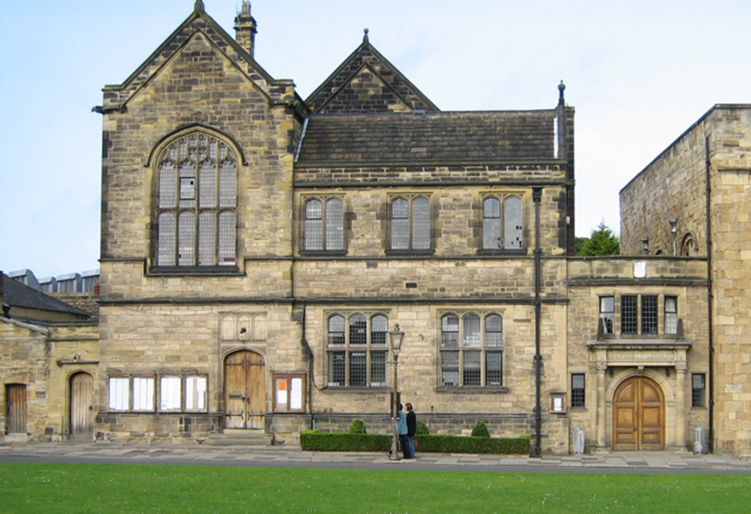
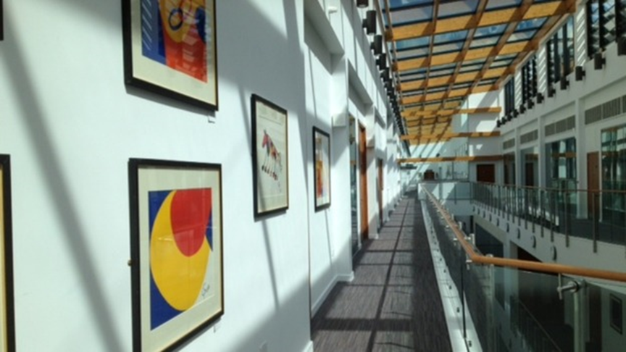
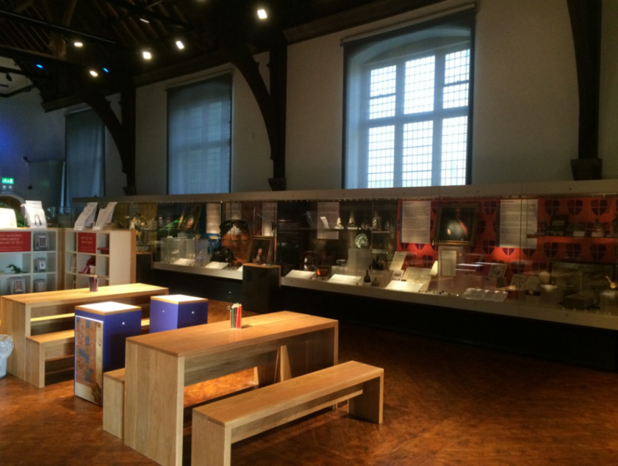
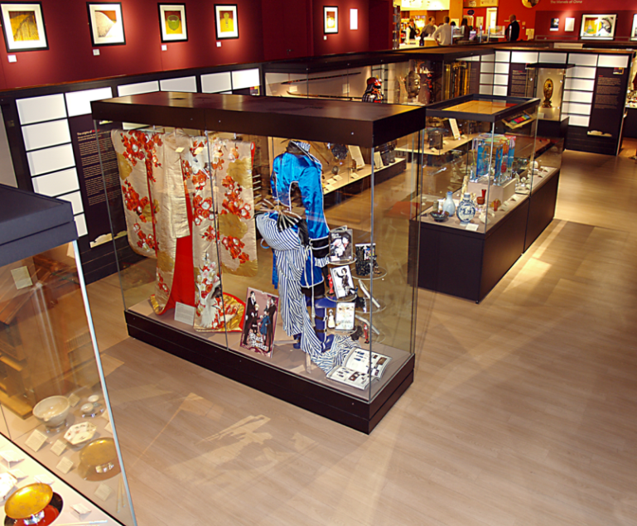
Durham University: Library and Heritage Collections

Slide 3
Resource Discovery System project
2009
Serials Solutions (ProQuest) launch Summon: web-scale library resource discovery
December: Ex Libris announces partner libraries for Primo Central
2010
Durham University starts assessing the market for discovery systems
2013
January: OJEU tender issued
Evaluated responses
April/May: Interviews and further discussions
Contract awarded to Ex Libris for Primo product
2014
New service, "Discover", launched ready for new academic year

Slide 4
What does Discover include?
Physical library collections (from Millennium system)
Electronic library resources (from Primo Central index)
Research repositories (open access publications and theses)
Archival collections (EAD catalogues)
Museum collections (from Adlib)
Departmental collections

Slide 5
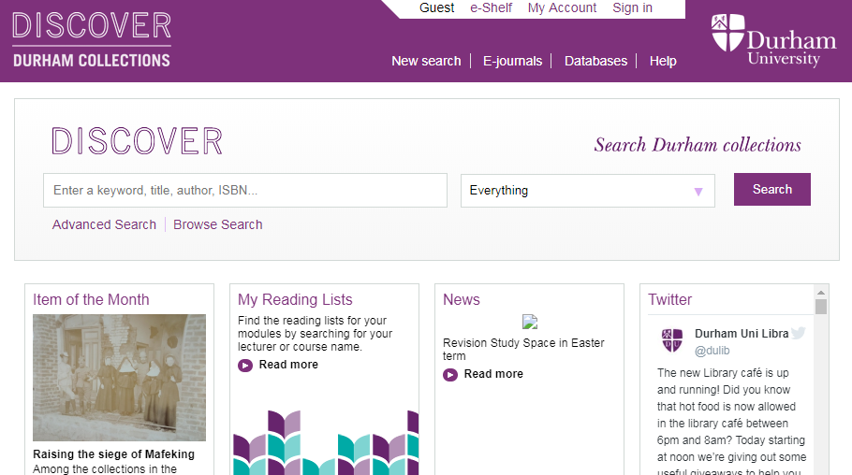
Demonstration
http://discover.durham.ac.uk/

Slide 6
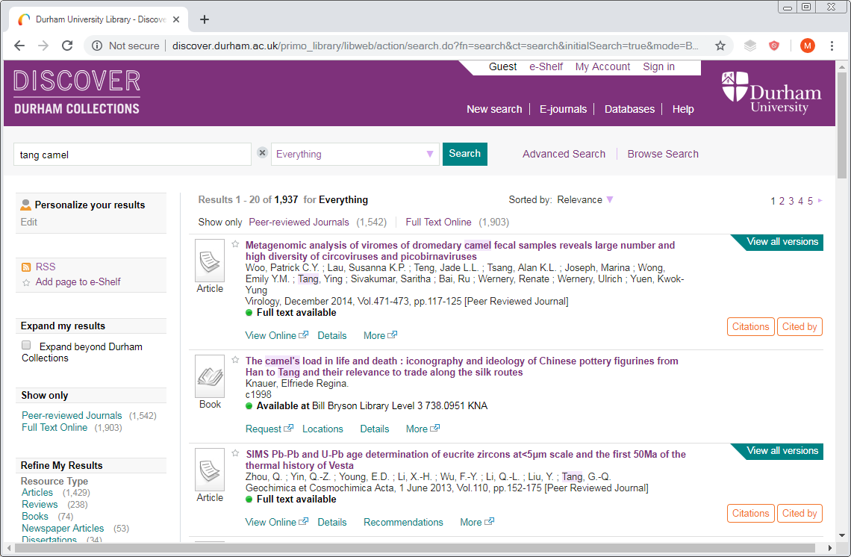

Slide 7
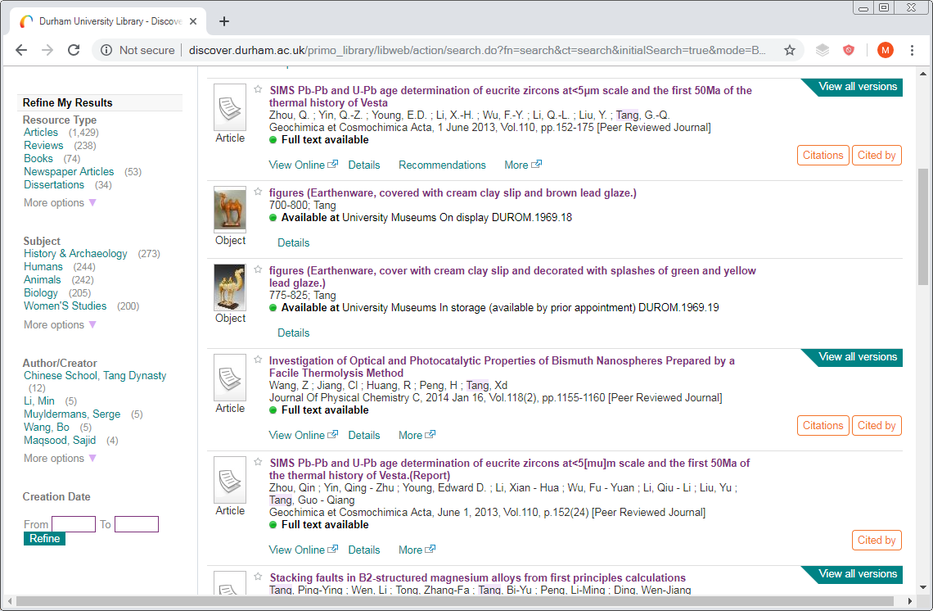

Slide 8
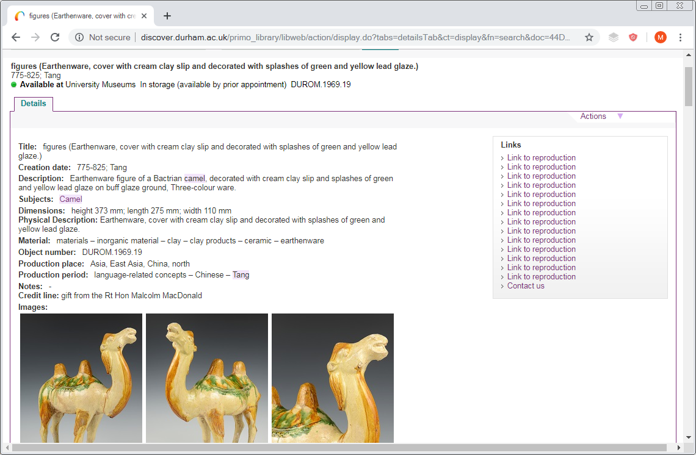

Slide 9
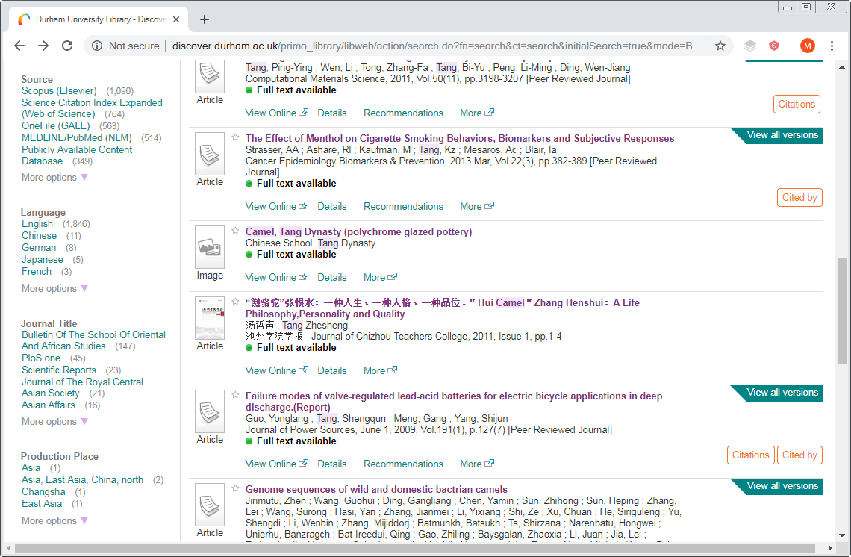

Slide 10
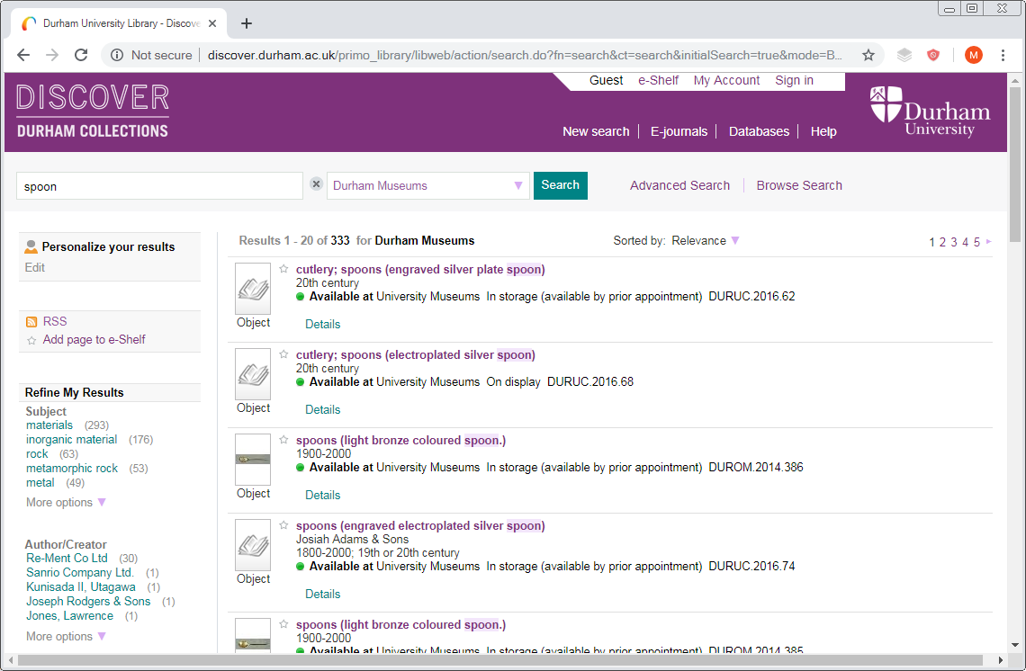

Slide 11
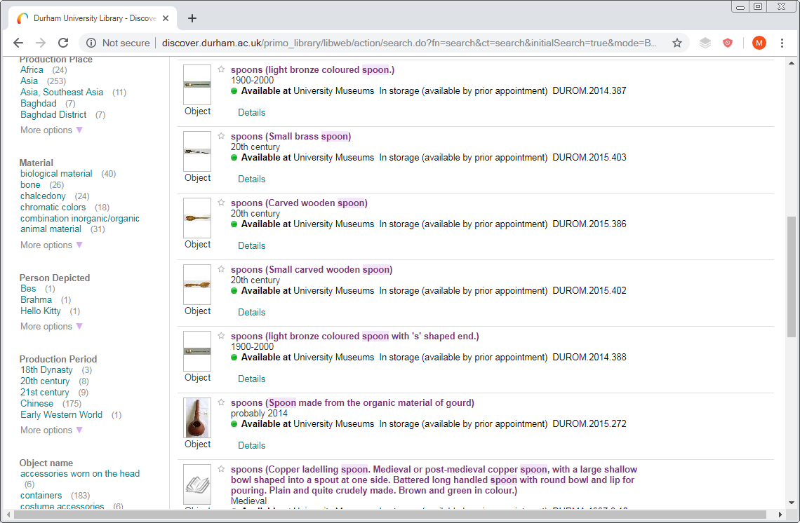

Slide 12
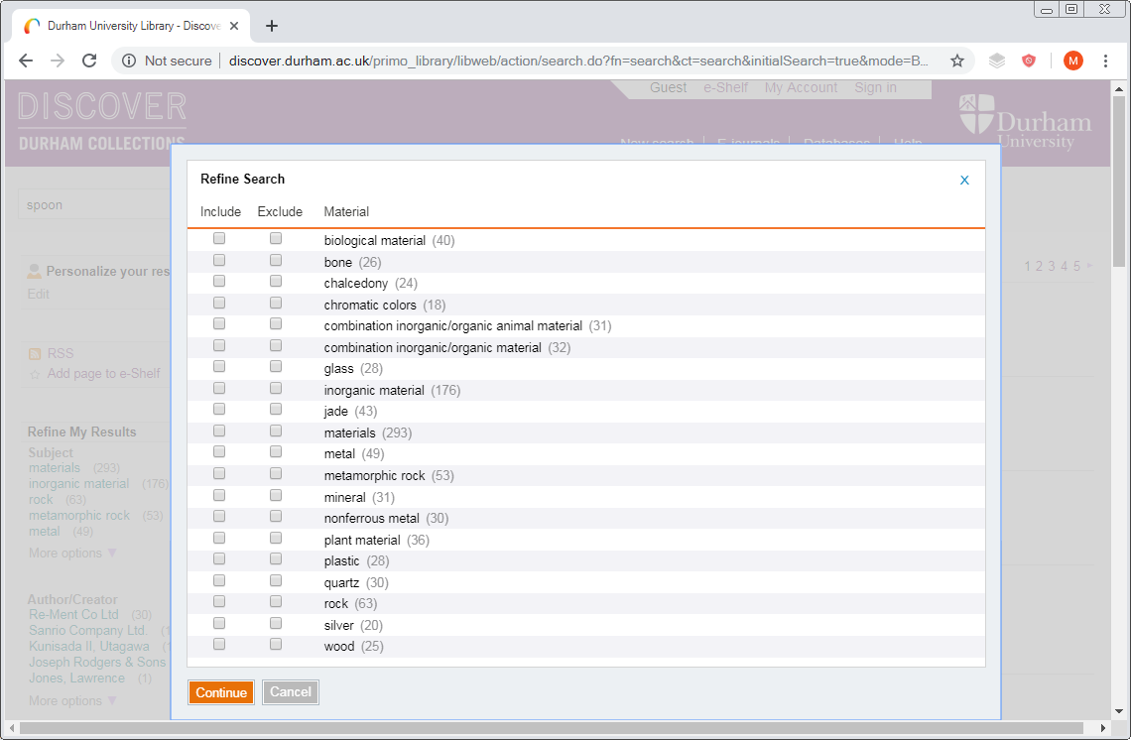

Slide 13
Making a library search work for museums
Pros:
Didn't have a public museum search interface before
Users do not have to go anywhere special to find museum objects
System is flexible enough to handle objects pretty well
Cons:
System still quite library focussed
Browsing collections not well supported

Slide 14
Standard facets
Resource type (e.g. book, map, video, article)
Subject (topic)
Author / Creator
Creation date (as an exact year)
Library (i.e. building location of physical item)
Source (e.g. an electronic collection)
Language
Journal title
Module name (for reading list material)

Slide 15
Local facets
Material
ceramic, jade, wood, cardboard, imitation leather
Production place
Lower Egypt, Guangdong, Samarqand
Production period
Eastern Han dynasty, 18th dynasty, Post medieval
Object name
teacups, incense burners, statues, posters, books
Person depicted
Buddha, Ganesh, Mao Zedong, Ciel Phantomhive

Slide 16
Person database: indexing
Mao Zedong
Used for: Mao Runzhi; Mao Tse-tung; Ziren; 子任; 毛泽东; 毛润之
Display fields
Mao Zedong
Facets
Mao Zedong
Keyword index
All variants indexed

Slide 17
Thesaurus: indexing enrichment
containers – culinary containers – drinking vessels – cups – teacups
Display fields
teacups forms part of the "title"
Facets
All levels indexed
Keyword index
All levels indexed and alternative terms

Slide 18
Processing fields for display
Perl script accesses API to read all objects as Adlib XML
Looks up Thesaurus and Persons to enrich indexing
Many fields passed straight through to Primo
Others need special handling:
Title
Dimensions
Creation date
Description

Slide 19
Creation date

Slide 20
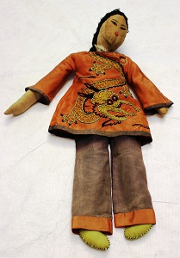
Dimensions

Slide 21
The title
Primo insists on a title!
Built from:
Title
Translated Title
Object Name
Other Name
Object Category
Physical Description
Material
Examples:
spoons (painted wood)
amulets (faience) lion and bull amulet
dolls (wood, silk, hair)
tea services (porcelain tea service with overglaze decoration)
全力支持抗美援朝志愿军部队 (Full support for the Volunteer Army to resist U.S. aggression and aid Korea)
Sentimental Circus Bento Chopsticks with Circus Animals
coins (metal) Didius Julianus Sestertius
snuff bottles (amygodoidal lava)
Welcome to the Space Show ( 宇宙ショーへようこそ)
ushabti (sycamore)

Slide 22
Popular titles
Search Engine
Optimisation
sherds (pottery) | 476
pottery (pottery) | 111
photographs (paper) | 99
animal bone (bone) | 90
clay pipe (fired clay) | 58
slide (glass) | 54
pages (paper, leather) | 47
unidentified (unidentified) | 41
coins (metal) | 38
body sherd (pottery) | 35
Could consider adding
production place or period
field location (for archaeology)
technique

Slide 23
Making data public
Selection of records (not missing, not loaned to us)
Accuracy, quality, consistency
Copyright (text and images)
Geolocation

Slide 24
Images
Current practice
JPEGs (typically 300 pixels) stored in Adlib
TIFFs stored on preservation-quality CDs and DVDs
User access
JPEGs available through Discover
Higher definition images only available through museum staff
Digital preservation
Risk of degrading of optical media
Risk of loss of discs

Slide 25
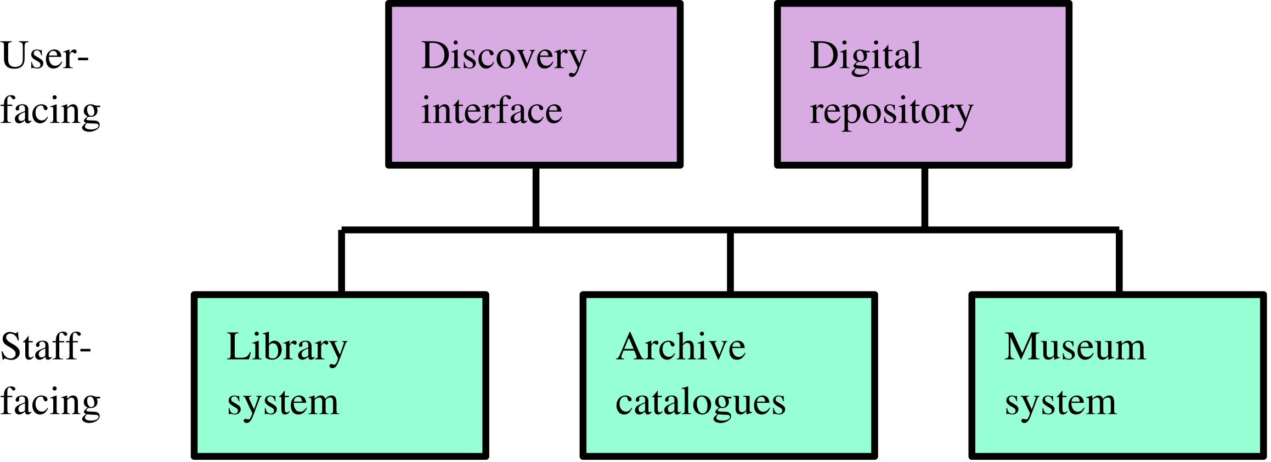
Library IT system strategy

Slide 26
Samvera repository
Research publications, theses, research data (including audio and video)
Manuscripts, archives and rare books
Museum objects, art
Born-digital special collections
Integration with discovery and metadata systems
IIIF image server
Digital preservation

Slide 27
IIIF
International Image Interoperability Framework
Eco-system with components working together across cultural heritage institutions
Example: https://bit.ly/2JiLT8j
Access | Protocol to fetch images at various magnification levels
Presentation | Order of pages in a book ("manifest"), table of contents, annotations
Authentication | Controlling what people can view
Search | Searching transcriptions, OCR and annotations

Slide 28
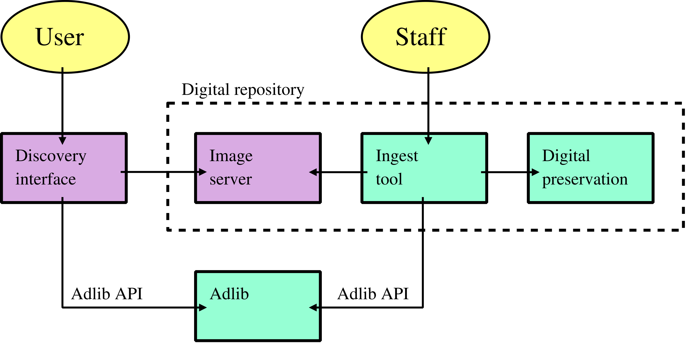
Architecture

Slide 29
Ingest tool

Slide 30
Ingest tool

Slide 31
Ingest tool

Slide 32
Ingest tool

Slide 33
Ingest tool

Slide 34
Ingest tool

Slide 35
Ingest tool

Slide 36
Ingest tool

Slide 37
Ingest tool

Slide 38
Ingest tool

Slide 39
Demonstration
EG2945 (limestone cartouche)
https://iiif.durham.ac.uk/jalava/ (experimental browsing interface)
DUROM.1960.3430 (Japanese carved ivory "devil's work" ball)

Slide 44
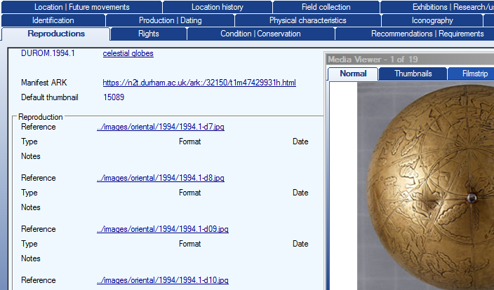
Technical integration
Adlib API
Write access to API
Additional fields (image database)
Canvas link
JP2K link
Label (front/back etc.)
Preservation system ID
Publish (yes / no / thumbnail only)
Link to viewer from objects

Slide 45
Technical challenges
Adlib API
Authentication
File access security issues
Defining ordering of images
Digital preservation
Faulty TIFF files

Slide 46
For the future...
Specialist search interface for heritage collections
Visual browsing of collections
Map-based exploration
Teaching tools and reading list integration
Online exhibitions
More departmental collections
Better metadata interoperability across library and museum
Grouping similar objects in results

Slide 47
Questions?
Matthew Phillips
m.e.phillips@durham.ac.uk
Helen Armstrong
h.m.armstrong@durham.ac.uk

Slide 48
Unique titles continued
14 sherds: 2 form parts of the handle of a jug, made of Reduced Greenware, dating to the late 14th to the 16th century, which have a brown glaze on the upper surface; 2 Oxidised Sandy ware body hollow-ware sherds are late medieval; the other 10 sherds are all Reduced Greenware hollow-ware body sherds with green-brown glaze externally dating to the late 14th to the 16th century

Slide 49
Ingest tool

Slide 50
Ingest tool

Slide 51
Ingest tool

